Slide 1

Where is the Love?
Shooting Incidents in the
City of Brotherly Love
Samantha Giordano

Slide 2
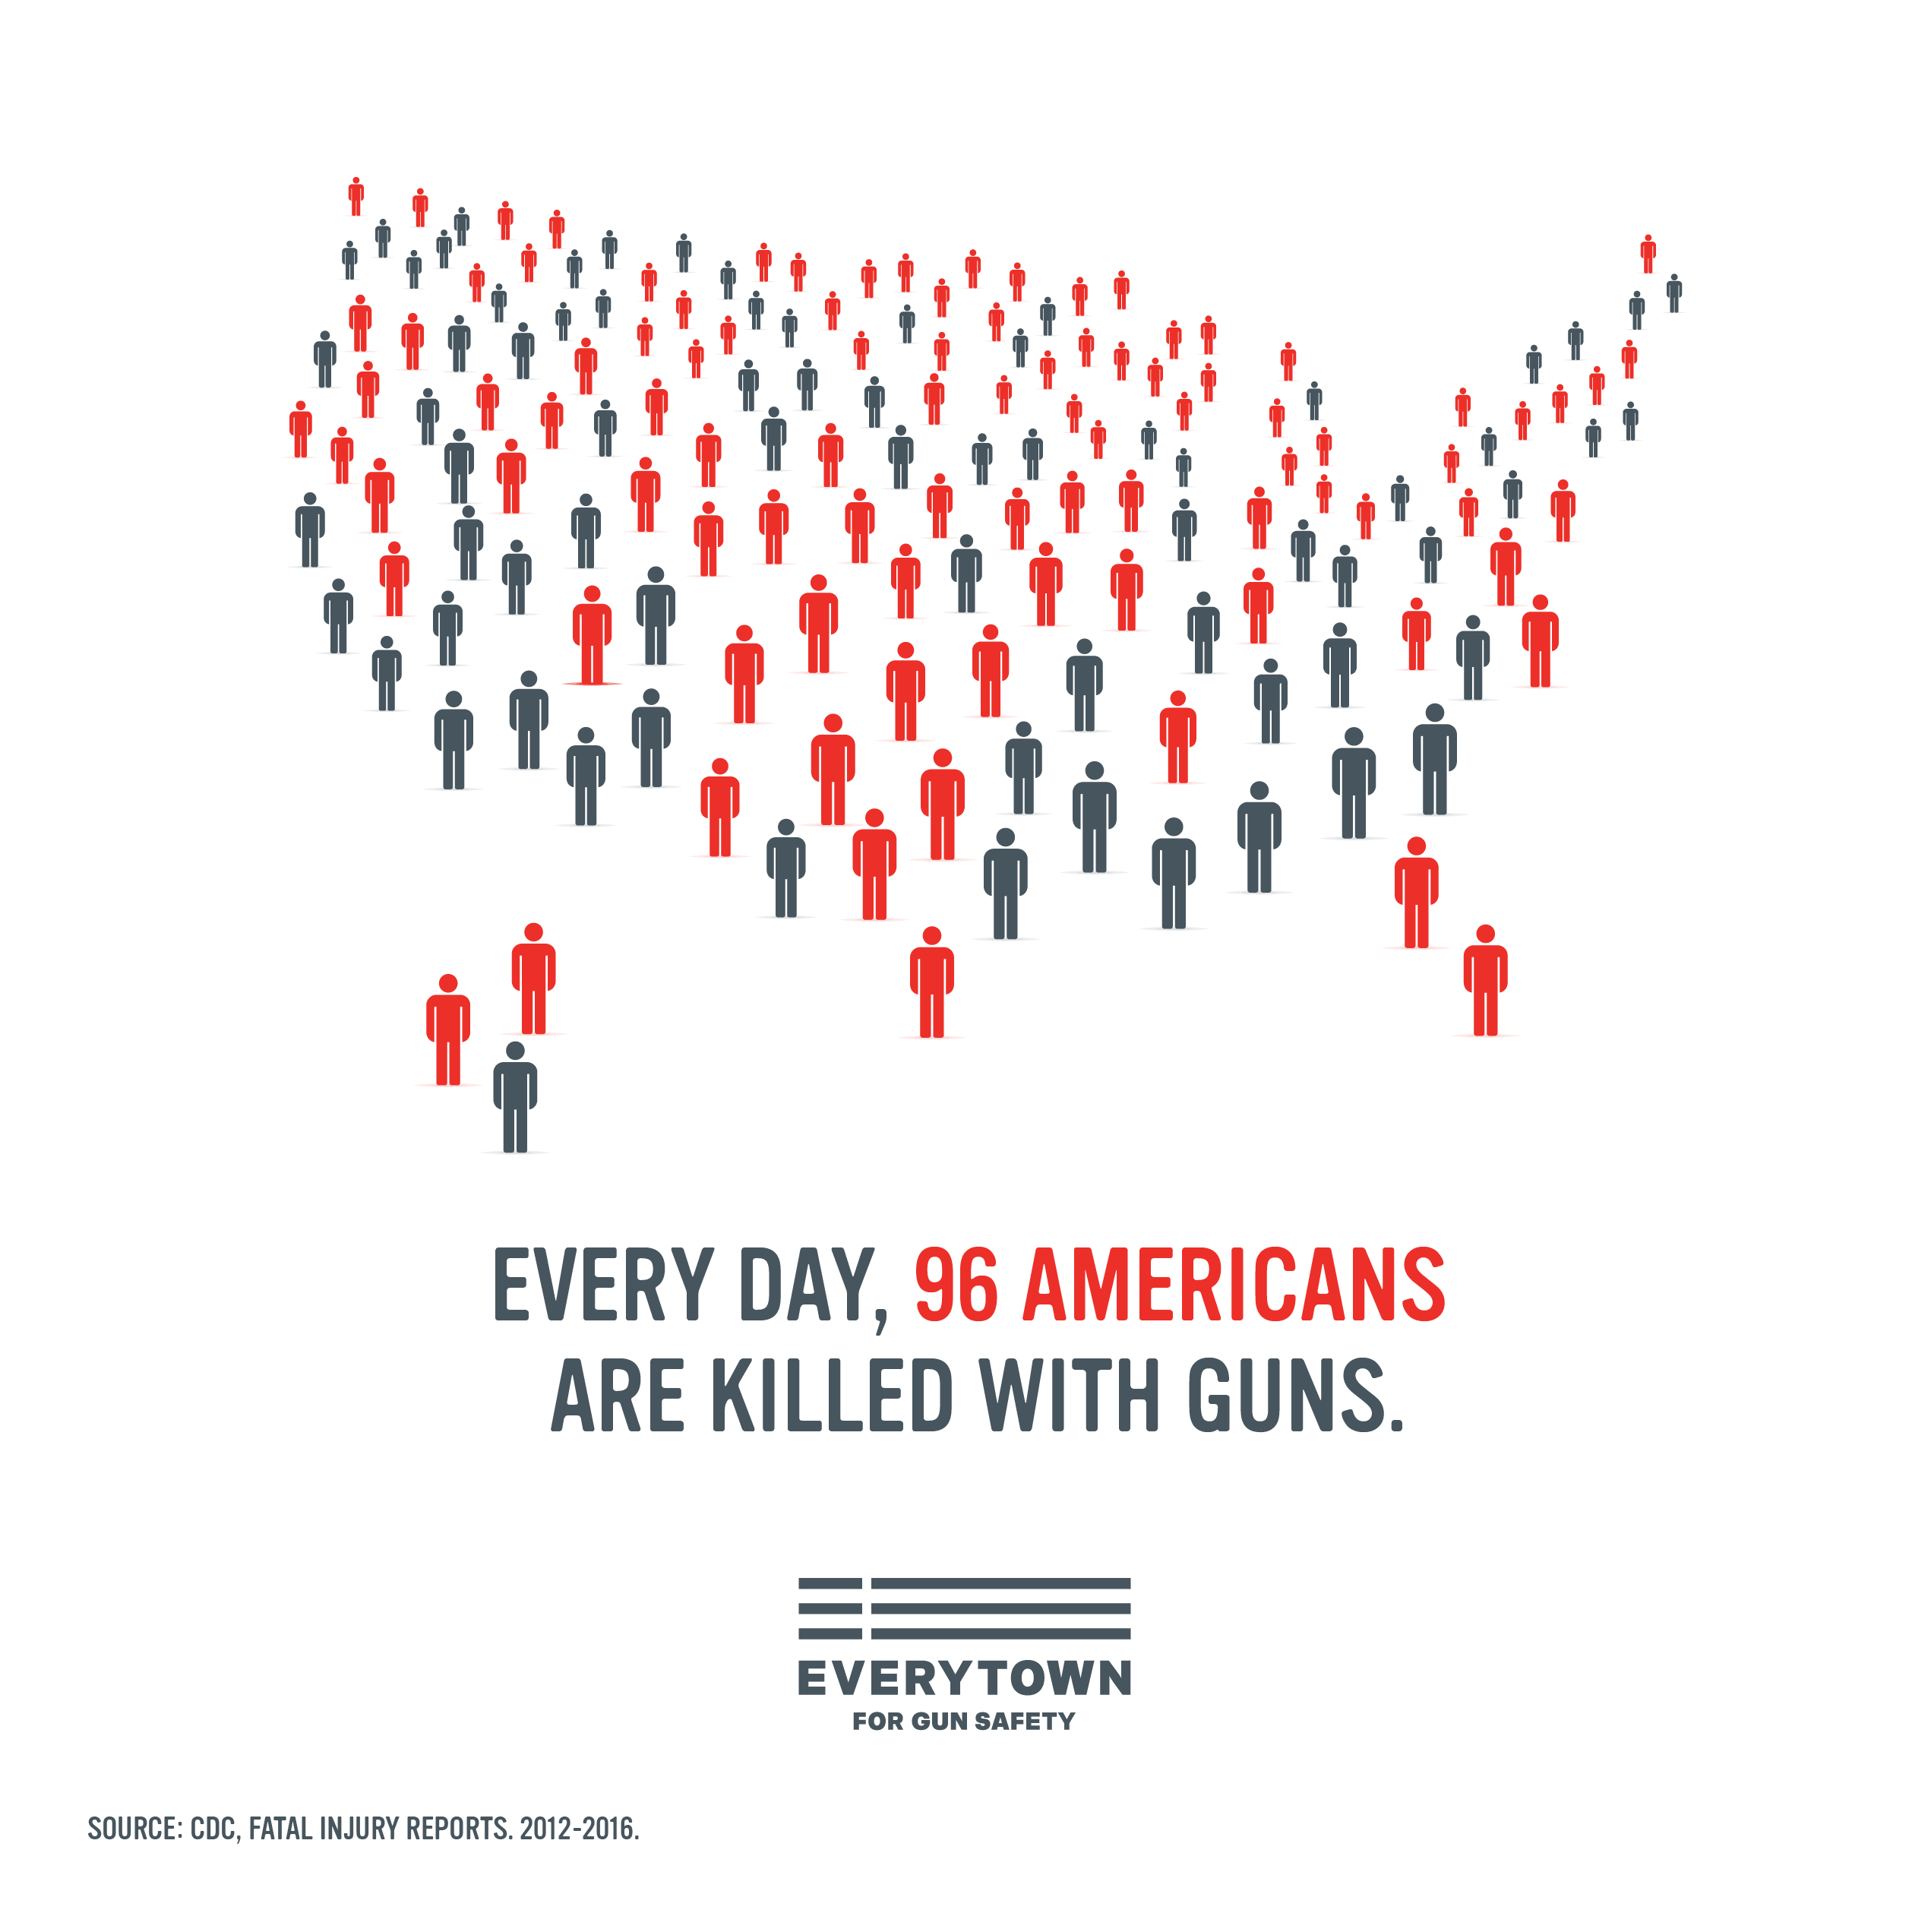
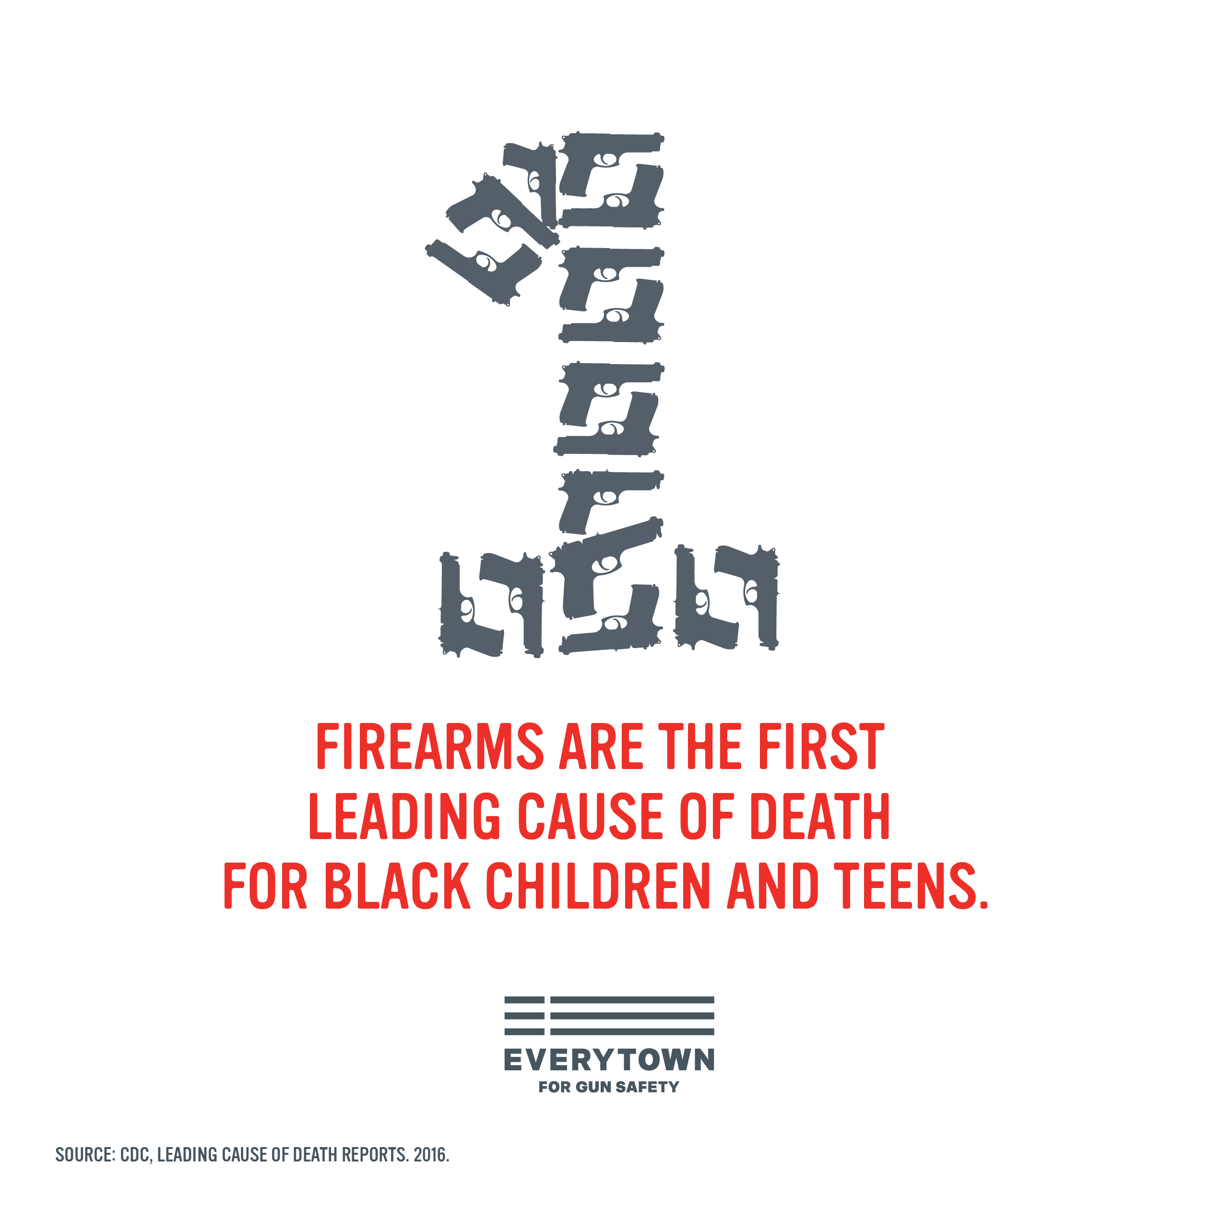
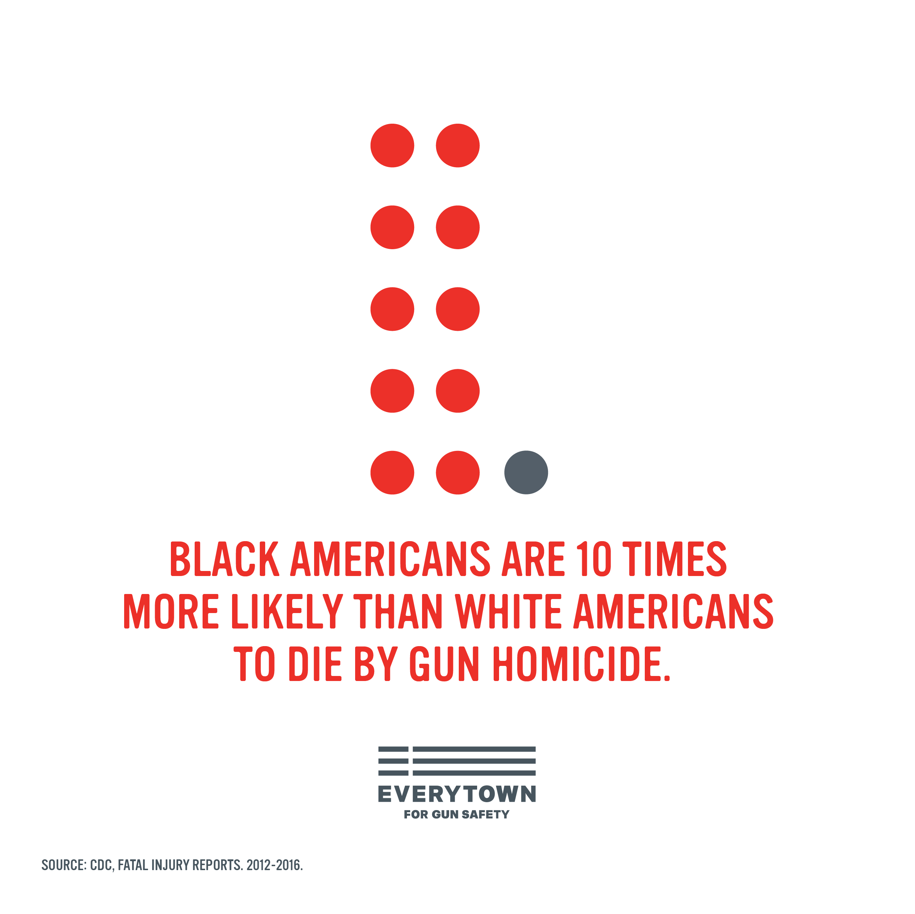
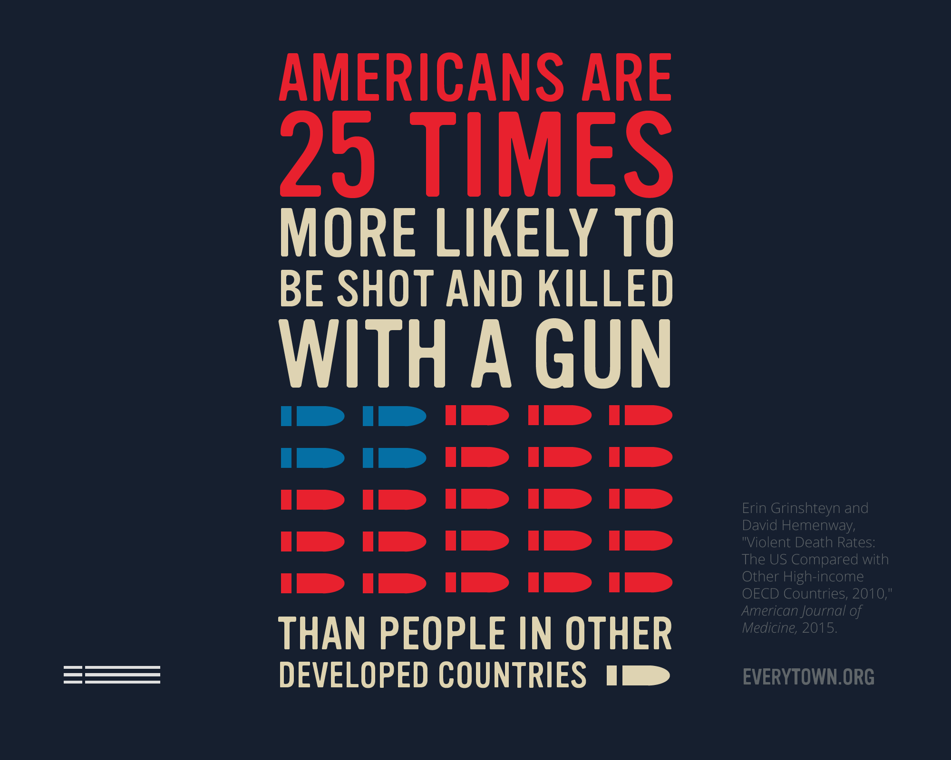
Everytown for gun safety

Slide 3
Philadelphia Shootings (The Inquirer)
From January 1 – December 5, 2018
1296 shootings
↑ 14.39% from 2017
234 fatal shootings
↑ 16.42% from 2017
From November 5 – December 5, 2018
116 shootings
↑ 20.83% from 2017
22 fatal shootings
↑ 69.23% from 2017

Slide 4
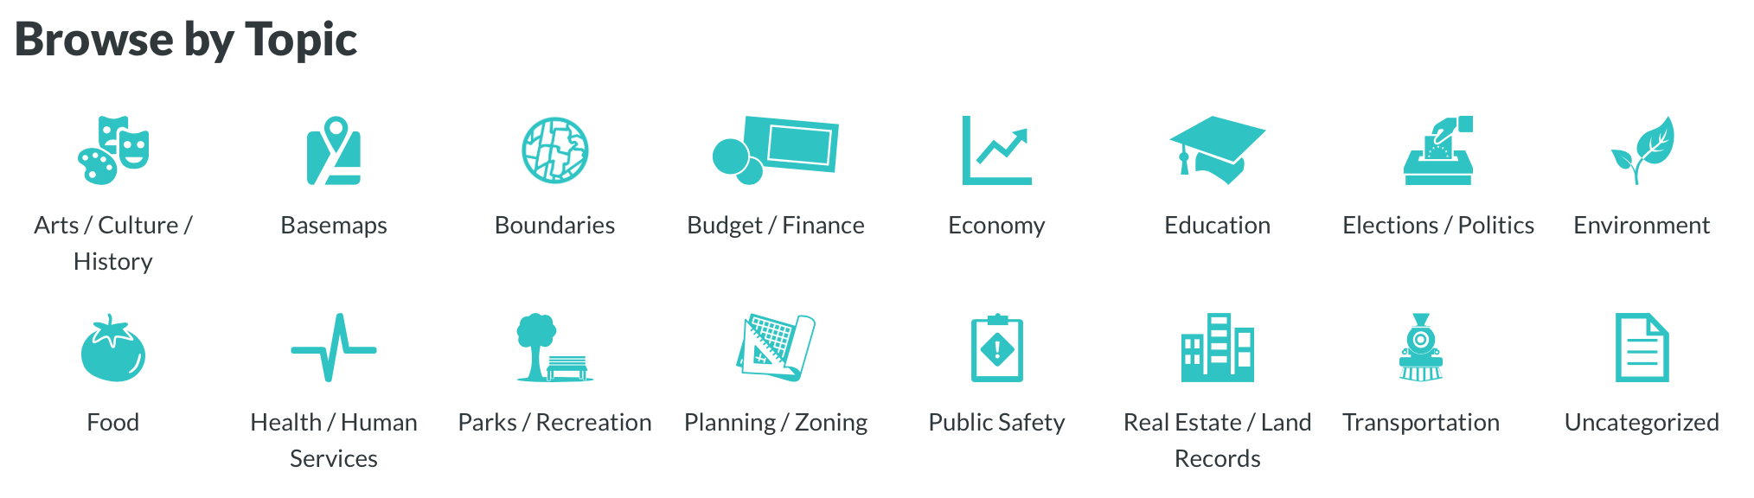
Data
OpenDataPhilly
Public Safety: Shooting Victims (Downloaded November 26, 2018)
5025 x 25
All shootings in Philadelphia since January 1, 2015
Officer Involved & Non-Officer Involved
Variables
Date, Long, Lat, Race, Sex, Age, Wound, Latino, Outside, Fatal, District
Officer Involved, Offender Injured, Offender Deceased

Slide 5
Goals
Are African Americans shot at more often than people of other races?
Has there been more shootings over time?
Where in Philadelphia are shootings most often occurring?
What are the trends with officer involved shootings in the city?

Slide 6
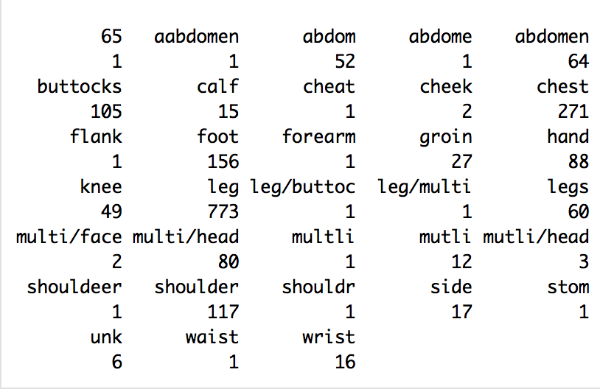
Data Cleaning
Upper case of all race and sex inputs
Case where sex=B and race=M
Combine wounds
81 unique cases combined down to 7 categories & NA
Removed doubled & unnecessary variables
Doubles of longitude/latitude, Inside, unique identifiers
Separated Date into Month, Day, Year
Separated full dataset into 2 datasets
Officer: officer involved shootings
Civilian: non-officer involved shootings

Slide 7
Officer Involved Shootings
67 incidents
Victim Statistics
23.88% killed
62.69% injured
98.51% male
Most shootings in May & August (regardless of year)
Top Districts
39 (Northwest) : 8 shootings
18 (Southwest) : 7 shootings
19 (Southwest), 22 (Central), 24 (East), 25 (East), 35 (Northwest) : 6 shootings

Slide 8
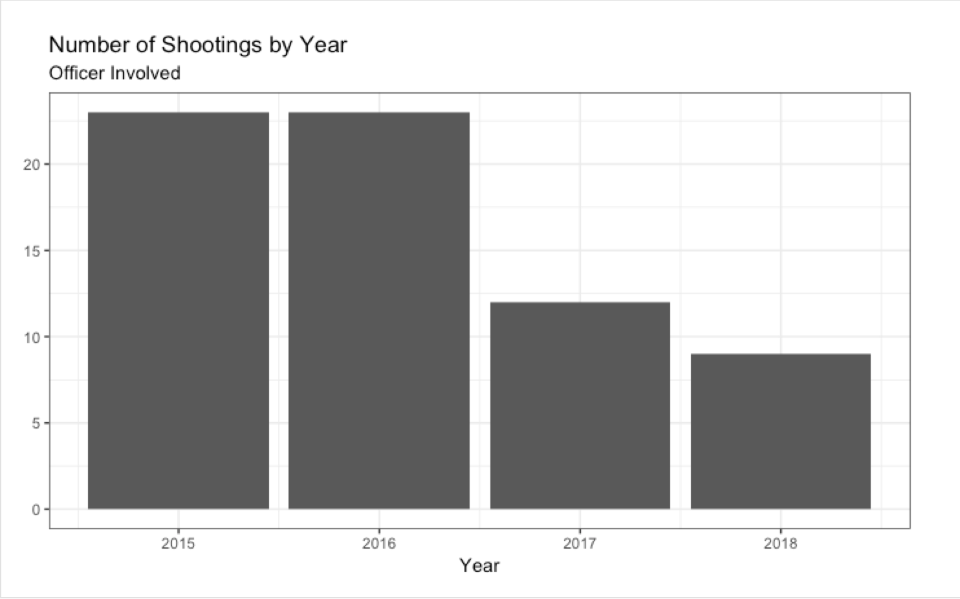
Officer Involved Shootings by year
2015 & 2016 most shootings at about 26
Large drop from 2016 to 2017
2018 – haven’t finished year so not fully accurate compared to other years

Slide 9
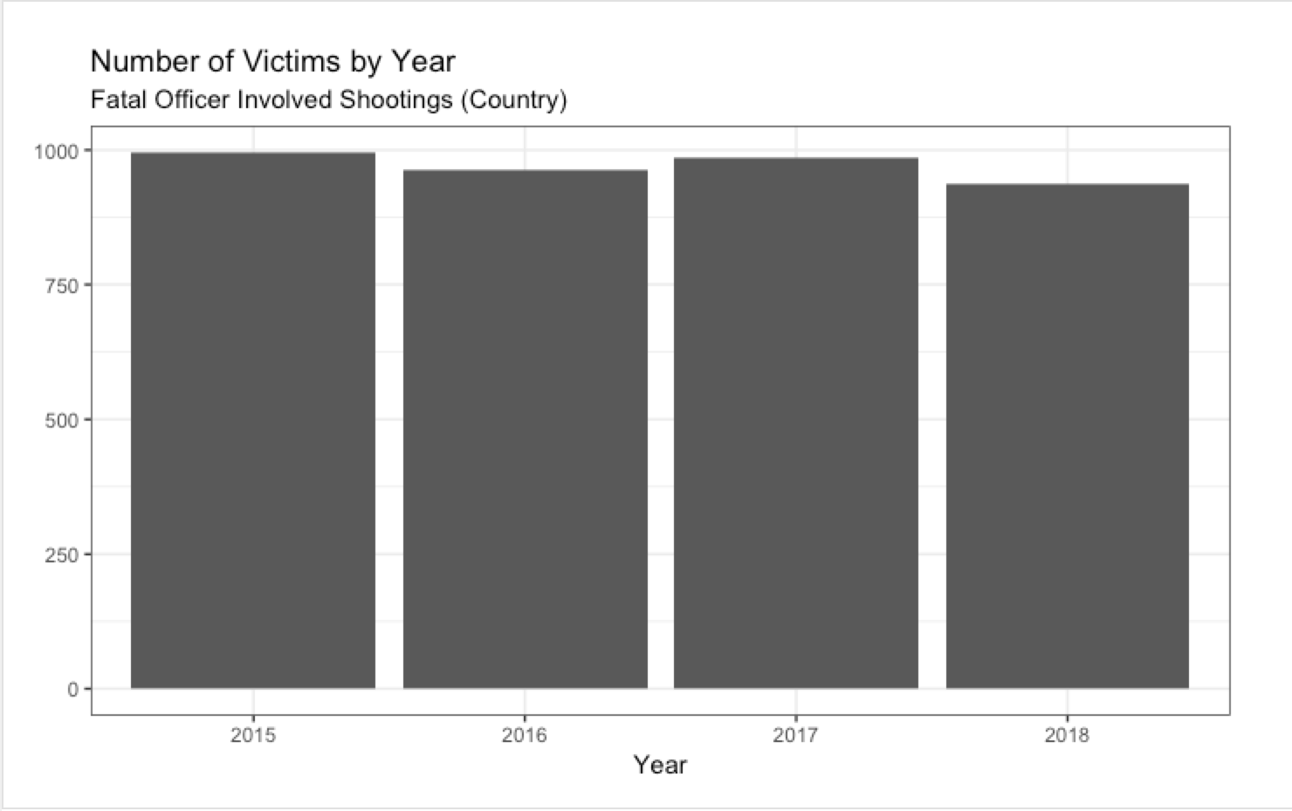
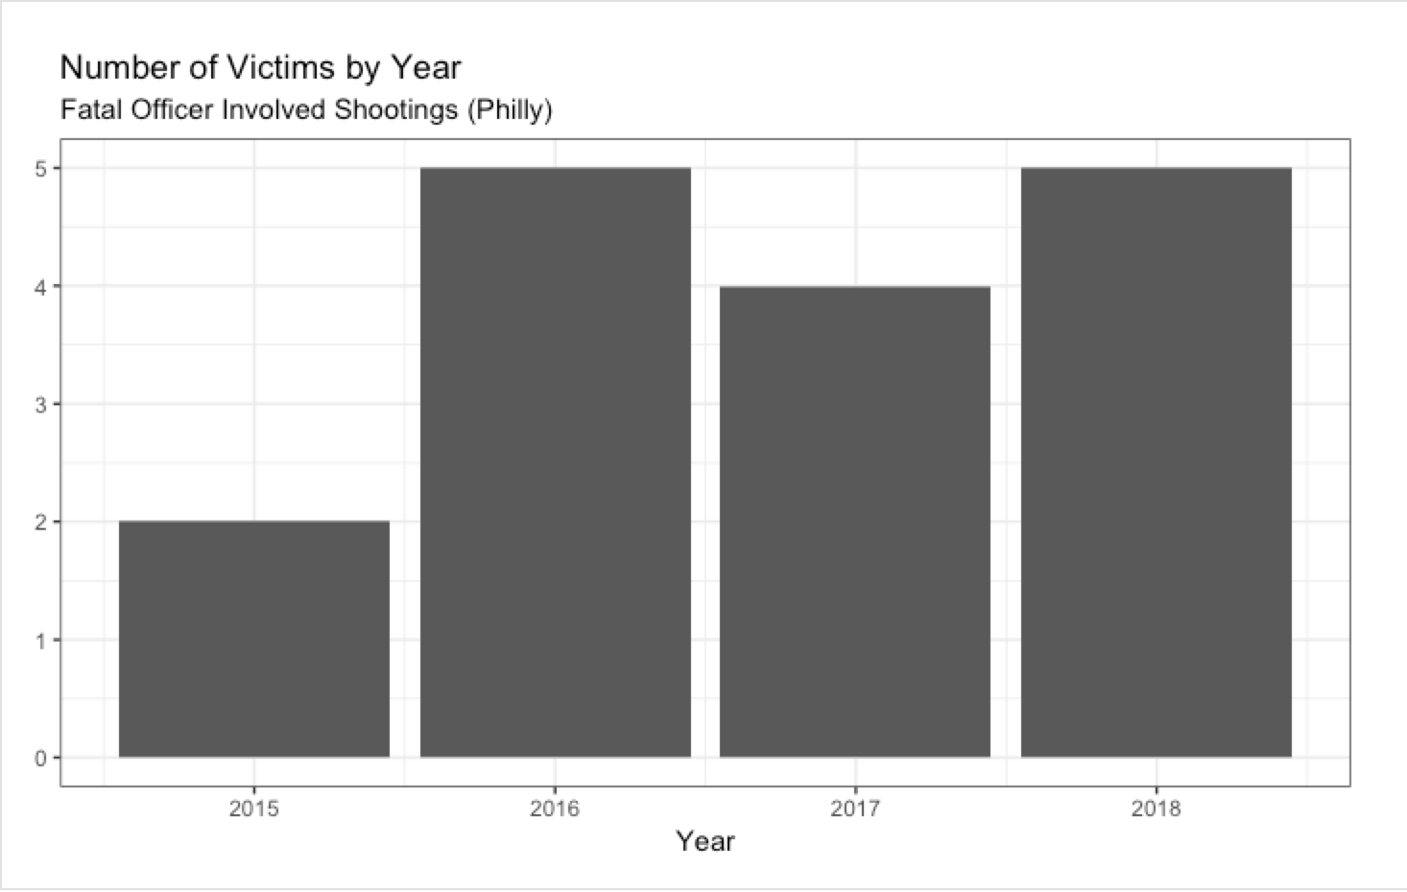
Officer Involved Shootings philly vs. country

Slide 10
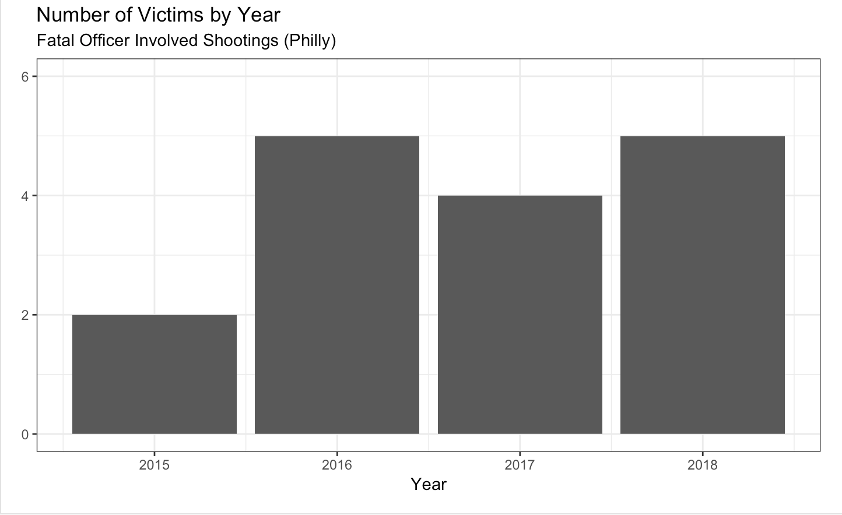
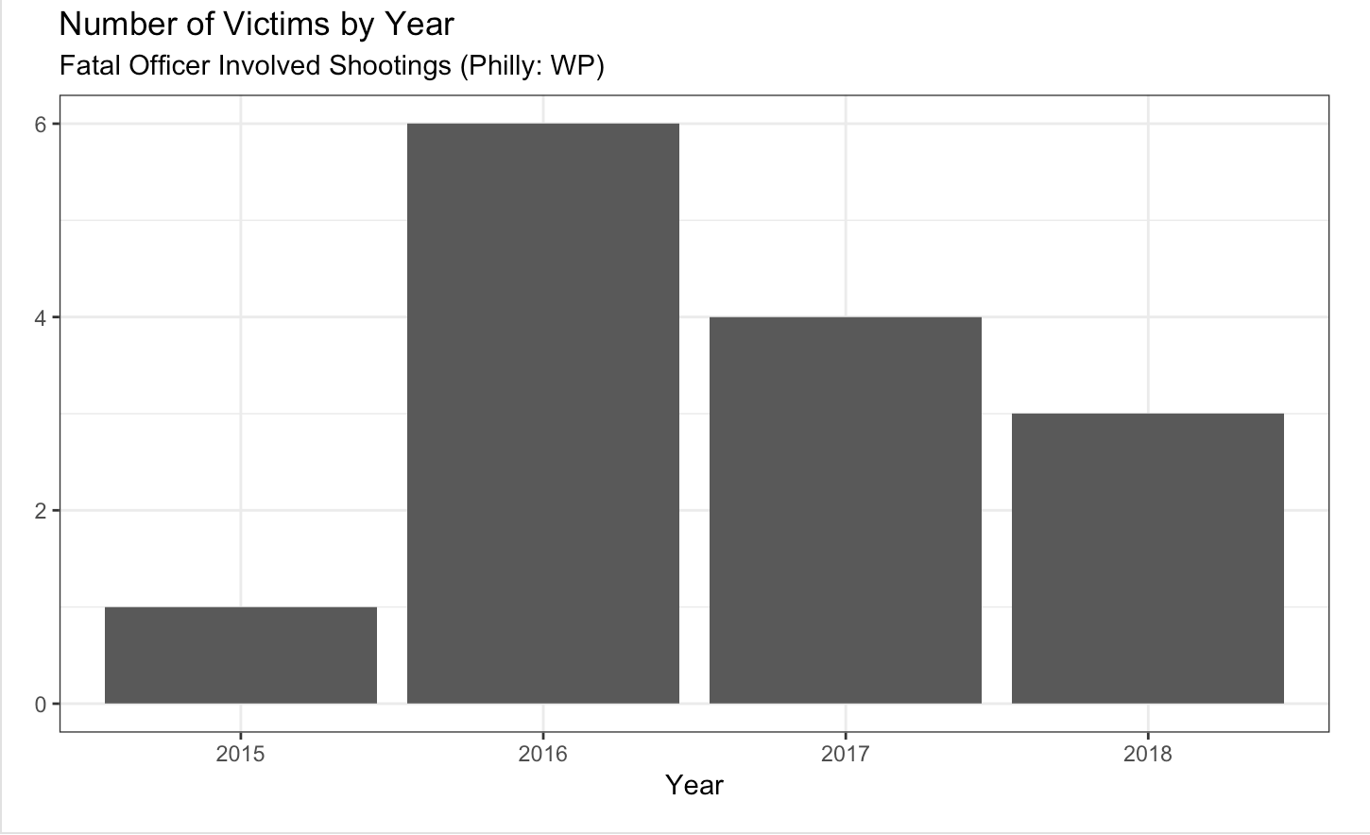
Officer Involved Shootings odp vs wp
OpenDataPhilly: 16 incidents
Washington Post: 14 incidents

Slide 11
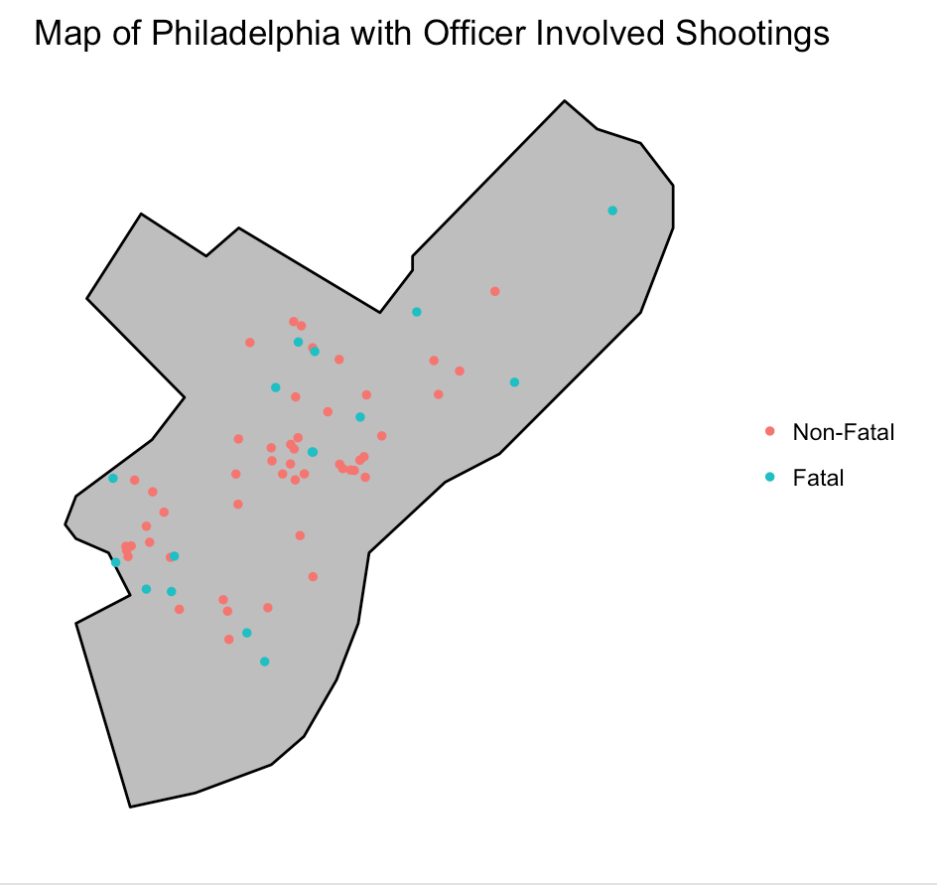
Officer Involved Shootings: Map

Slide 12
Civilian Shootings
4958 incidents
Victim Statistics
91.99% male
93.65% shot outside
Most shootings in August & July (regardless of year)
Wound | Count | Prop
Arm | 425 | 8.57%
Back/Butt | 407 | 8.21%
Face/Head | 724 | 14.60%
Leg | 1274 | 25.70%
Multi | 1267 | 25.55%
Shoulder | 128 | 2.58%
Torso | 695 | 14.02%
NA | 38 | 0.77%

Slide 13
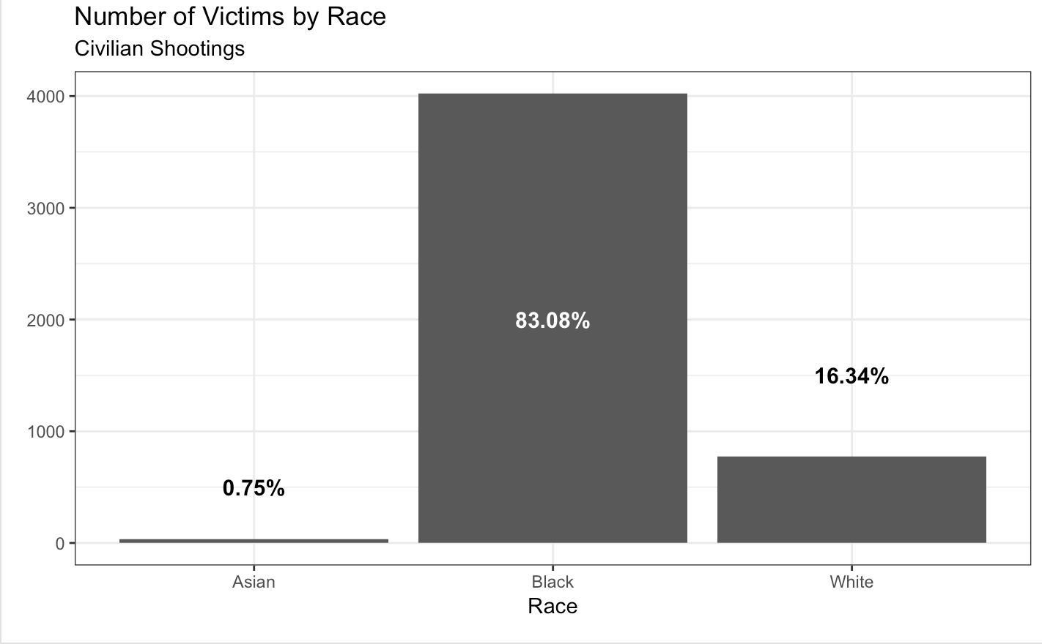
Civilian Shootings by race
Possible Races
Asian, Black, White, Native American, Other
Majority Black
As of 2016
44.8% White
44.2% Black
7.4% Asian
0.8% Native American
2.3% Other
Race distribution of sample does not follow race distribution of Philly

Slide 14
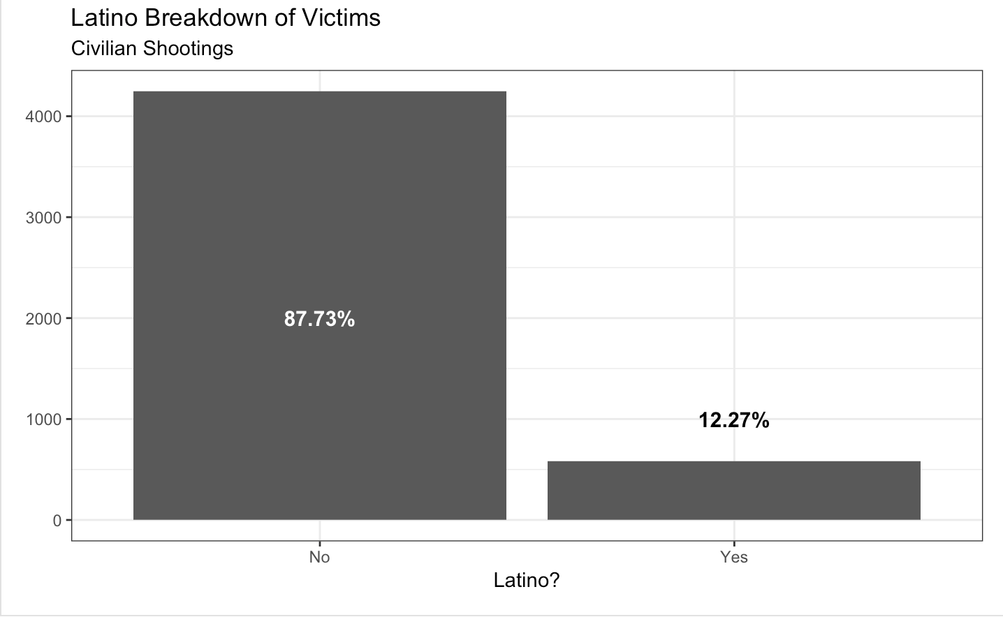
Civilian Shootings by latino
Majority non-Latino
As of 2016
13.6% Hispanic and/or Latino
Latino distribution of sample does follow Latino distribution of Philly

Slide 15
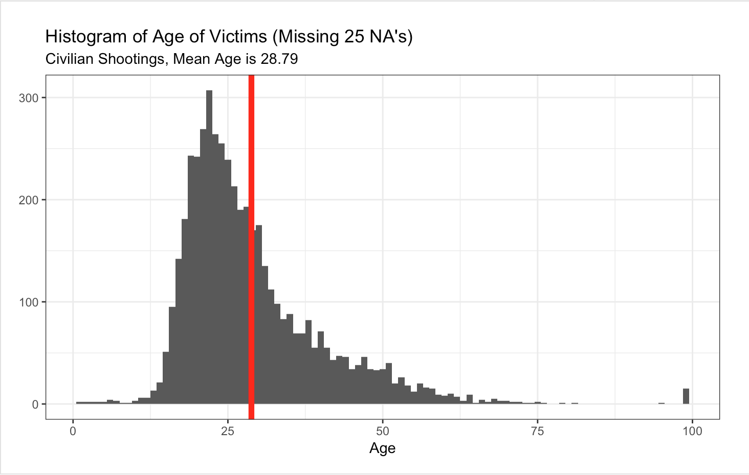

Civilian Shootings: Age

Slide 16
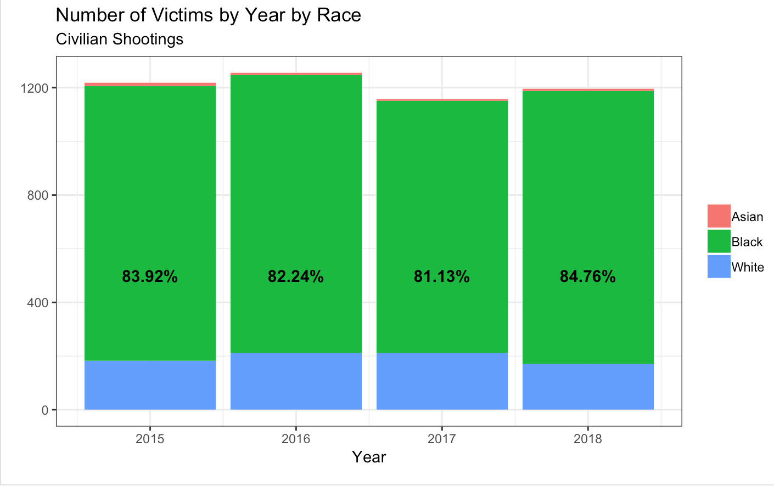
Civilian Shootings By Year/race
2016 most shootings
2017 least shootings
2018 is incomplete
Could potentially be highest year
About 81% - 85% victims are Black

Slide 17
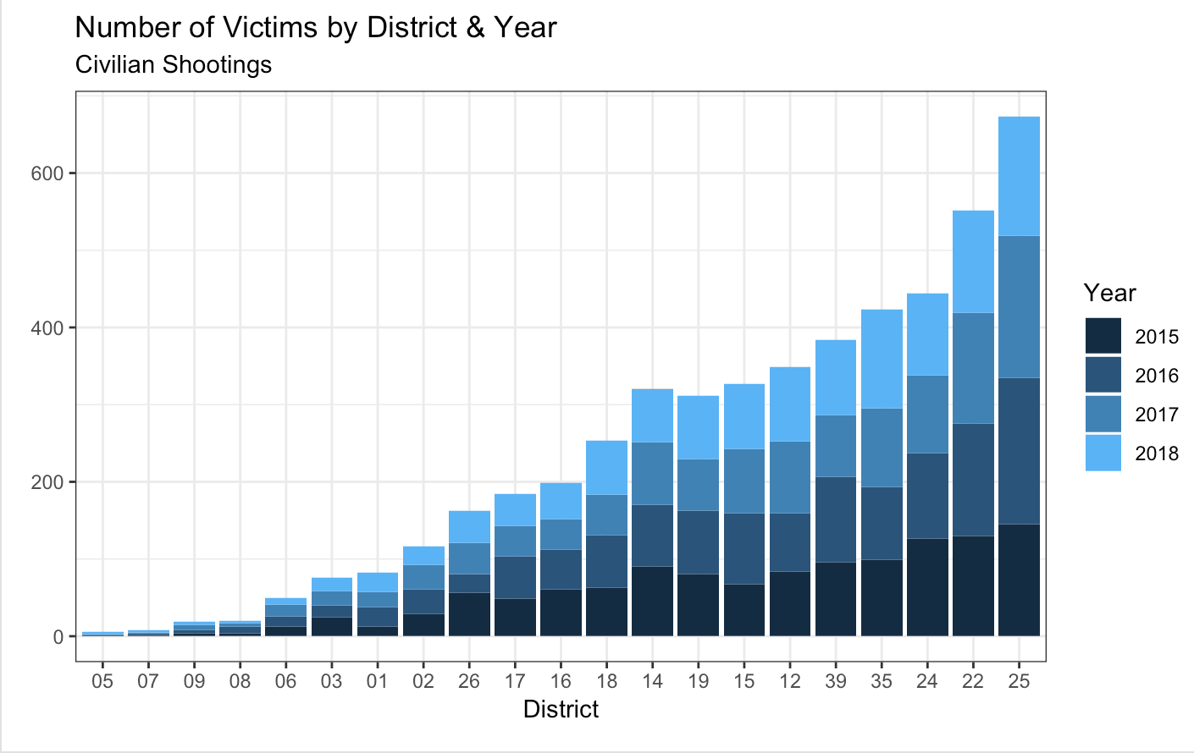
Civilian Shootings By district/year
Top 5 Most Violent
25 (East), 22 (Central), 24 (East), 35 (Northwest), 39 (Northwest)
Share borders
All Southwest districts 200 or more shootings
12, 16, 18, 19
3 of 4 Northwest districts 300 or more shootings
14, 35, 39

Slide 18
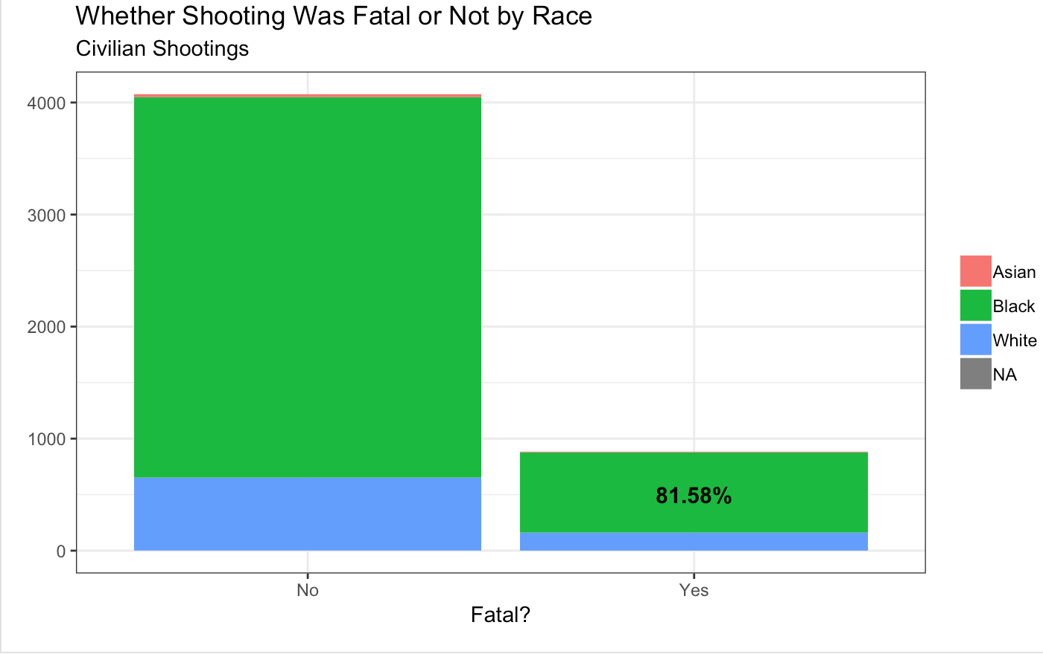
Civilian Shootings By fatal/race
17.85% killed
81.58% were Black

Slide 19
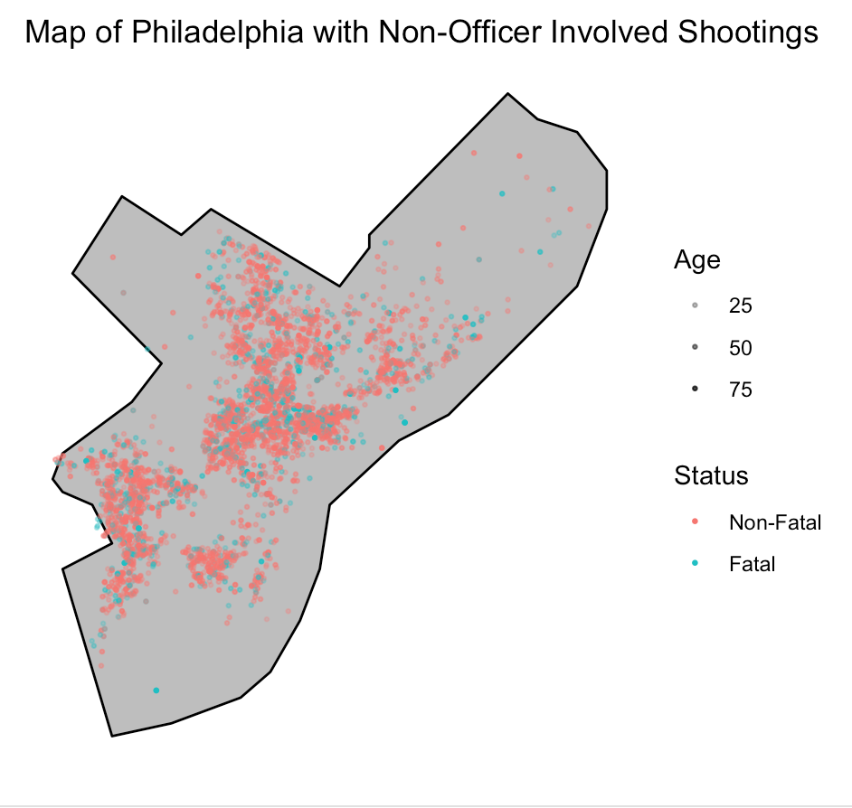
Civilian Shootings: Map

Slide 20
Conclusions
Officer Involved Shootings
Lowering over time
Civilian Shootings
Blacks are being shot at greater rates than other races
Not worsening over time, also not getting lower
Southwest & Northwest Philly seem to be the most violent areas
What can be done?
Gun reform
Education
Poverty reduction
Healthy/positive convo between police & community
Community/neighborhood restoration

Slide 21
Challenges, Surprises & Future
Challenges
Figuring out how to create map of Philadelphia
Surprises
% of injured victims in OIS data
Age minimum & maximum
Percentage of fatal shootings
Future Research
If race was available for OIS
Socioeconomic, other crime info on districts

Slide 22
Questions?

Slide 23
References
https://everytownresearch.org/gun-violence-america/
http://data.philly.com/philly/crime/shootings/?
https://www.opendataphilly.org/dataset/shooting-victims
https://en.wikipedia.org/wiki/Demographics_of_Philadelphia
https://www.pewtrusts.org/en/research-and-analysis/reports/2017/11/philadelphias-poor
https://phys.org/news/2018-02-crime-gun-violence-stabilize-neighborhoods.html

